Slide 1

Hackathon
August 2nd, 2020

Slide 2
Team 10

Slide 3
1. Problem description

Slide 4
Problem description
Predict the probability of a plane arrive late* to its destination.
Challenges:
It is our first hackathon
The database has time dependencies, so it is necessary to be careful on how to split it
Most of the features have high cardinality, so it is necessary to treat it
A lot of ideias and a short time to implement
*a plane is considered delayed if it arrives more than 15 minutes after the scheduled time.

Slide 5
2. Workflow

Slide 6
2.1 Data preparation

Slide 7
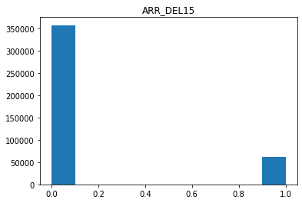
EDA (exploratory data analysis)
15 features
419.487 observations
14,8% of delayed
2 repeated features (IDs)
1 features with a unique value
NaN values to be handle

Slide 8
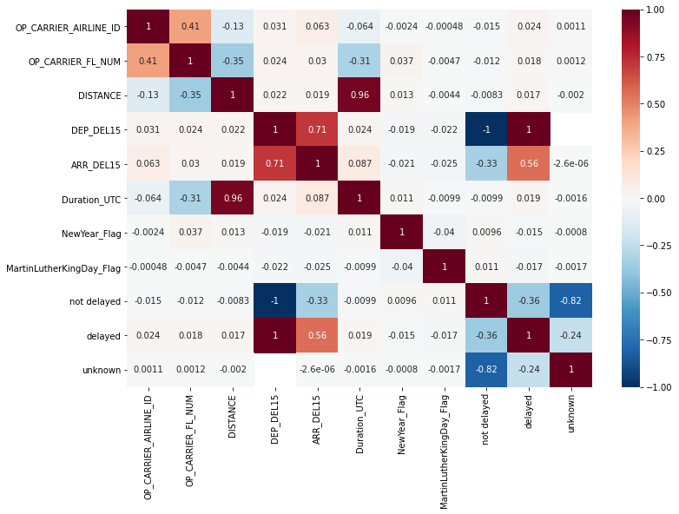
Correlation Matrix

Slide 9

Data preprocessing
Split of train dataset based on dates instead of a random split, because of the time dependences: 30% newest date as test database
Transform object feature to datime feature to be able to do calculations and create new features
Drop features that are irrelevant (one value (CANCELLED) or repeated information (depature and arrival IDs))
Treat features with high cardinality
Create new features
Create a pipeline to test different models

Slide 10
2.2 Model selection

Slide 11
Model selection
Baseline Model
Default Logistic regression with 6 features
AUROC Test (train.csv) = 0.902288
AUROC test.csv = 0.830
Version 2
Decision Tree with 6 features
AUROC Test (train.csv) = 0.90406
Other versions
Adicional features do try to improve previously good results
Last version
Default Logistic regression
AUROC Test (train.csv) = 0.90547
AUROC test.csv = 0.830

Slide 12
2.3 Results and discussion

Slide 13

Results and discussion
The Best Model
AUROC test.csv = 0.83
Good accuracy
Simple and intuitive interpretation of the features

Slide 14
3. Future Work

Slide 15
Future work
Test others kind of models (like catboost)
Hyperparameters tunning
Implement more features

Slide 16
The End!

Slide 17
Pun!

